Slide 1

Property Sales to analyse Profits and improve Customer relationship
Analytical CRM
Kauthami Tatipala
X16133757
MSc Data Analytics
x16133757@student.ncirl.ie

Slide 2
Introduction
REASON
1. What are the Profits?
2. Invest or advertise which area to grow the business?
3. Customer chioce and preference according to age?
DATA
Two datasets have been considered here and they are in excel sheet, cleaned by openrefine and emerged together to use.
The datasets are taken from data.gov from USA open data website.
The attributes include Customer details, the brokers/angents details, property details,

Slide 3
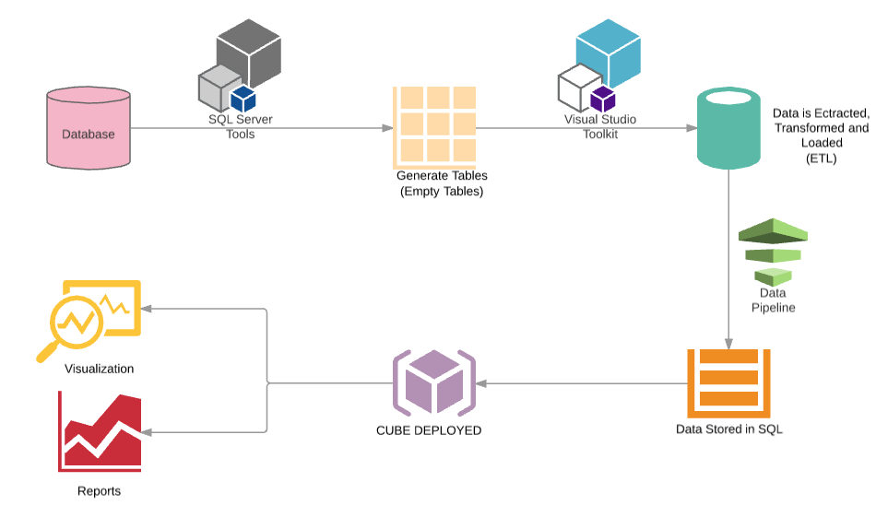
Implementation
METHODOLOGY
Tables are generated to store the data, in sql server management studio.
The data is extracted, transformed, and loaded using SSIS process in visual studio.
When the data is ready it is loaded in the empty tables generated.
Using SSAS methodology the cube is formed and deployed to get the analytical results.
Later with the deployed cube the reports can be generated, for further deep understanding of the data that is been used.
The reports are been visualized using Tableau for visulaize access to huge data with digestible visuals.

Slide 4
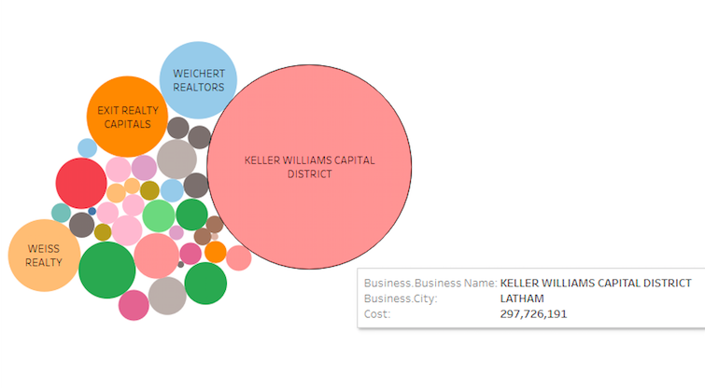
Results
Business Organization with much profits
This report gives the details of the business organization which are more popular based on how many properties they have sold and also the profits they have earned.
It is clearly giving the competition view for the organisations, Keller Williams Capital has the highest profitble organization.

Slide 5
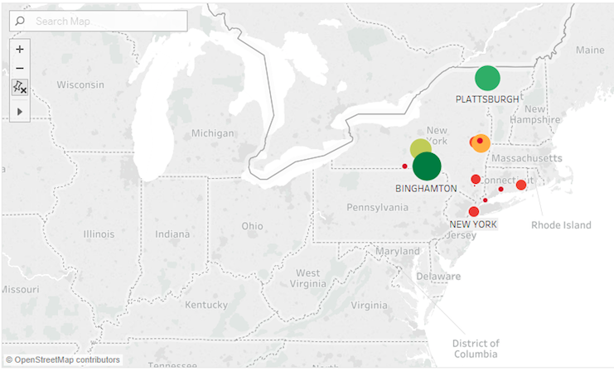
Result
Geographic Vs Sales
This report gives the idea of where the properties are more sold in USA.
It is based on the customers interest and and also the gemographic locations.
Binghamton is in top of the area where properties and sold and then comes the plattsburgh.

Slide 6
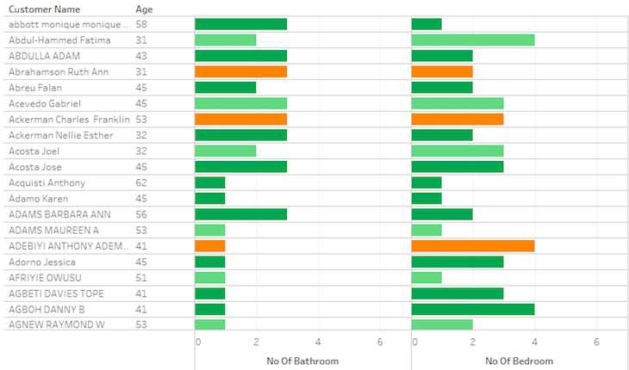
Result
Customer Preferences.
This visualization gives the details of the Customers preferences about the property what they want to take.
Here i have taken the bedrooms and bathroom preferences.
With this kind of analysis the customer relationship can be developed by showing the properties according to the age they will select.

Slide 7
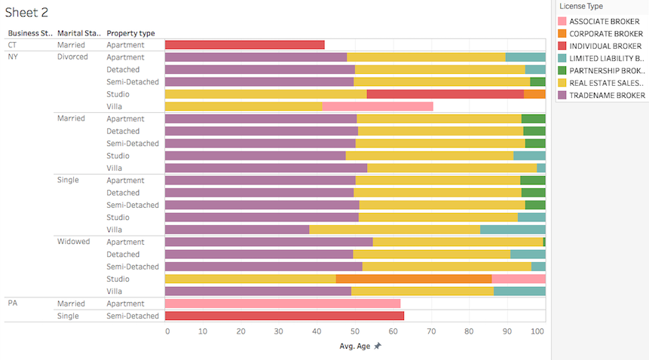
Result
Type of Agents Vs Type of property
This report shows the agents types who are selling what kind of property to customers with marital status included.
By this the organization can predict the future sales in area based on the customers what they are purchasing kind of property.

Slide 8
References
Bin, O., 2004. A prediction comparison of housing sales prices by parametric versus semi-parametric regressions. Journal of Housing Economics, 13(1), pp.68-84.
Wu, L. and Brynjolfsson, E., 2015. The future of prediction: How Google searches foreshadow housing prices and sales. In Economic analysis of the digital economy (pp. 89-118). University of Chicago Press.
Zhou, W.X. and Sornette, D., 2008. Analysis of the real estate market in Las Vegas: Bubble, seasonal patterns, and prediction of the CSW indices. Physica A: Statistical Mechanics and its Applications, 387(1), pp.243-260.
Yoshpe, H., 1936. THE DeLANCEY ESTATE: DID THE REVOLUTION DEMOCRATIZE LAND-HOLDING IN NEW YORK?. New York History, 17(2), pp.167-179.

